Slide 1










ConnectX
GUIDED BY
Dr.Ram Singh Manohar
PRESENTED BY
Ananya Agrawal

Slide 2


1
Introduction
5
Flow Chart
Table of content
2
Existing Software
6
ER Diagram
3
Tech Stack
4
Features

Slide 3


About
Explore social media with this user-friendly platform that has a nice look and lots of features. Easily create and explore posts, and enjoy a strong authentication system and quick data fetching using React Query for a smooth user experience.
B

Slide 4


Existing Software
Facebook
Instagram
snapchat

Slide 5





Tech Stack
Typescript
Nodejs
Git
Tailwind CSS
ReactQuery
Expressjs
Back to Agenda

Slide 6

Features
Edit Profile
Search
Like and comment
View Profile
Create Account
USER
Logout
Delete Account
Login
Post Content
Delete Content
Chatting
View Feed

Slide 7




FEATURES
1
Authentication
2
Explore Page
3
Like and Save Functioanlity
4
Detailed Post Page
5
Profile Page

Slide 8
1
2
3
Browse Other Users
Create Post Page
4
Edit Post Functionality
5
Responsive UI with Bottom Bar
seamless
Chatting

Slide 9
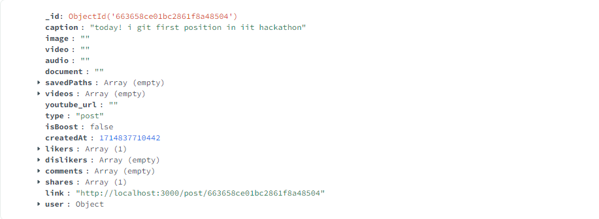
Post Details
Back to Agenda

Slide 10
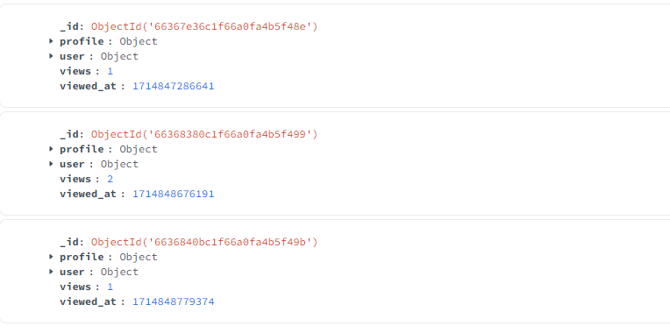
Profile Viewers

Slide 11
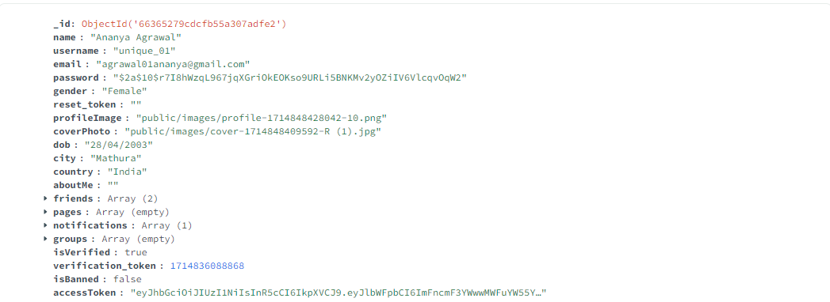
Users Data

Slide 12
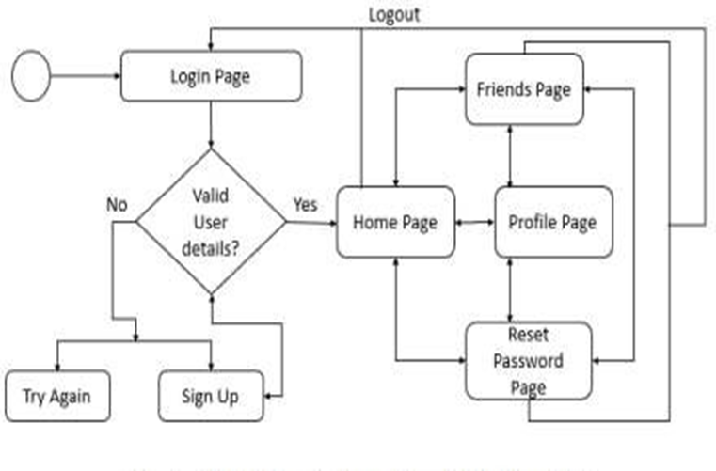
Flowchart

Slide 13
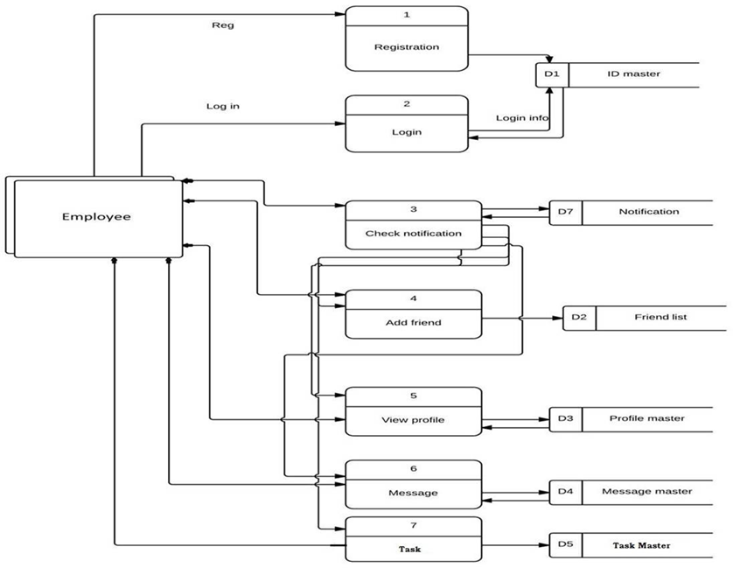

ER Diagram

Slide 14
Future Scope
Create Page
Create Group
Events
Customer Support

Slide 15
Thank You

